Slide 1




Larissa bogdanova
CEO IBC HUMAN RESOURCES RECRUITING AGENCY
Operates in Russia since 1996 www.ibchr.ru
PRESIDENT OF ASSOCIATION OF RECRUITING AGENCIES (ARA) www.arau.su
www.arau.su

Slide 2

The global workforce gap by 2030
Shortage of Skilled Workers - 85.2 mln.
Shortage in Technology - 4.3 mln. specialists worldwide
Shortage of Healthcare Workers - 15 mln. doctors, nurses

Slide 3

The global workforce gap by 2030
Shortage of Workers in Industry and Manufacturing - 2.1 mln.
Global Teacher Shortage - over 69 mln. new teachers.

Slide 4

The workforce shortage worldwide
In the USA – 6.5 million by 2030
In Europe – 2 million by 2030
In Russia – 4 million people

Slide 5
From 2025 to 2030 Top 9 of the most promising fields are
1. Artificial Intelligence and Machine Learning Specialists.
2. Data Analysts and Data Scientists.
3. Cybersecurity Specialists.
4. Biotechnology and Genetics Experts.
5. VR/AR Developers and Virtual Reality Specialists.
6. Environmental and Sustainability Specialists.
7. Robotics and Automation Engineers.
8. Healthcare Professionals (Telemedicine and Digital Health).
9. Online Education Instructors and Mentors.

Slide 6
Building a career as a recent graduate is a vital process
Six recommendations to succeed in careers:
1. Gain Experience through Internships and Volunteering.
2. Continuously Develop Your Skills:
Soft skills. Communication. Teamwork. Time management. And problem-solving skills will help you succeed in any job.
3. Build a Professional Network.
4. Create and Develop Your Personal Brand.
5. Learn from Mentors. Find a mentor.
6. Keep Updating Your Knowledge and Learning New Things.

Slide 7
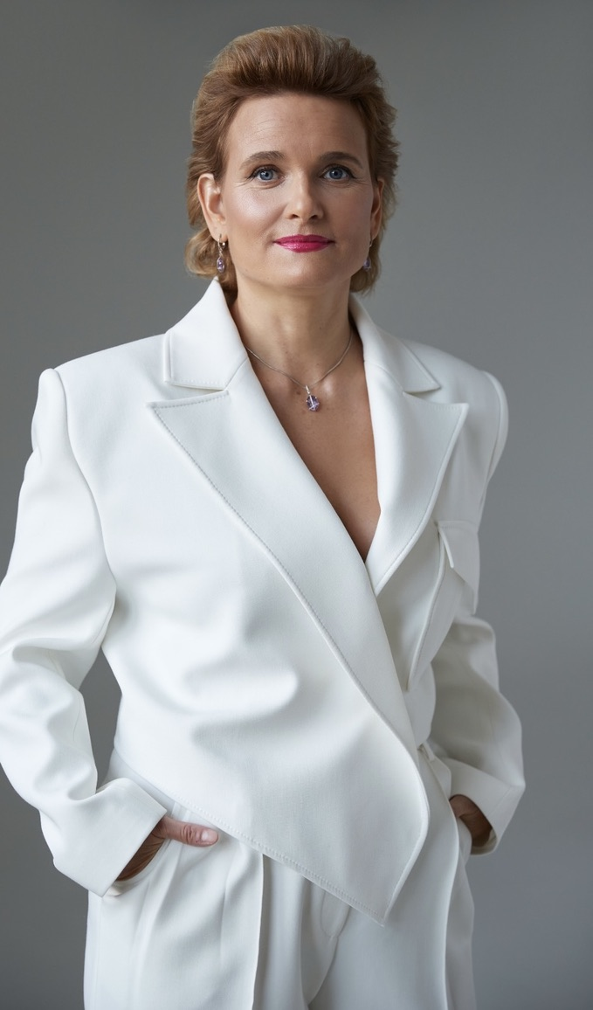
CONTACT US TODAY
8 800 707 5580
hr@ibc.ru
CEO LARISSA BOGDANOVA
www.ibchr1.ru

